Slide 1
Final Project Presentation
Digital Attendance Register
Team Members:
Silas Silas (223075361)
Joba Elikana (223081965)
Geoffrey Sankandi (222034726)
Module:
WAD621S - Web Application Development
Lecturer:
Ms Josephina Muntuumo
October 2, 2025

Slide 2
Contents
Introduction & Background 3
Problem Statement & Objectives 3
Problem Solved . . . . . . . . . . . . . . . . . . . . . . . . . . . . . . . . . . . . . 3
Objectives Achieved . . . . . . . . . . . . . . . . . . . . . . . . . . . . . . . . . . 3
The Implemented Solution 3
Key Features . . . . . . . . . . . . . . . . . . . . . . . . . . . . . . . . . . . . . . . 3
Technology Stack . . . . . . . . . . . . . . . . . . . . . . . . . . . . . . . . . . . . 4
Application Showcase 4
Project Outcomes & Conclusion 6
Outcomes . . . . . . . . . . . . . . . . . . . . . . . . . . . . . . . . . . . . . . . . 6
Conclusion . . . . . . . . . . . . . . . . . . . . . . . . . . . . . . . . . . . . . . . . 6

Slide 3
Introduction & Background
Most educational institutions and organizations have long relied on paper-based atten- dance registers. These traditional sign-in sheets are inefficient and prone to common issues such as physical damage, loss, and manipulation. Furthermore, they make it ex- tremely difficult to track attendance records efficiently over time or aggregate data.
Our project, the Digital Attendance Register, was developed to solve this problem. It replaces insecure paper sign-in sheets with a secure, reliable, and efficient web-based so- lution. By digitising the attendance tracking process, our application saves time, ensures data accuracy, and makes data retrieval and analysis instantaneous.
Problem Statement & Objectives
Problem Solved
The project directly addresses the core problems of manual attendance registers:
They are inefficient and time-consuming.
They are error-prone, leading to inaccurate records.
They make it difficult to monitor trends or verify late arrivals.
Objectives Achieved
The general objective was to develop a user-friendly web application to digitally record, track, and store attendance. We successfully met all specific objectives:
Created an HTML-based attendance form for user sign-in.
Used JavaScript to validate input and automatically highlight late arrivals in red.
Implemented a PHP back-end to securely process and store the attendance data.
Utilized a MySQL database to act as a persistent, secure log for all attendance records.
Generated daily attendance summaries and reports for administrators.
The Implemented Solution
The final product is a functional, web-based attendance register system that allows users to sign in digitally. The system architecture is built on a classic, robust technology stack.
Key Features
Simple Sign-In Form: A clean, responsive front-end built with HTML and CSS.
Real-Time Validation: JavaScript provides immediate feedback and highlights late arrivals.
Secure Back-End: A PHP back-end processes all data and communicates with the database.
Persistent Storage: A MySQL database securely stores all attendance logs.

Slide 4
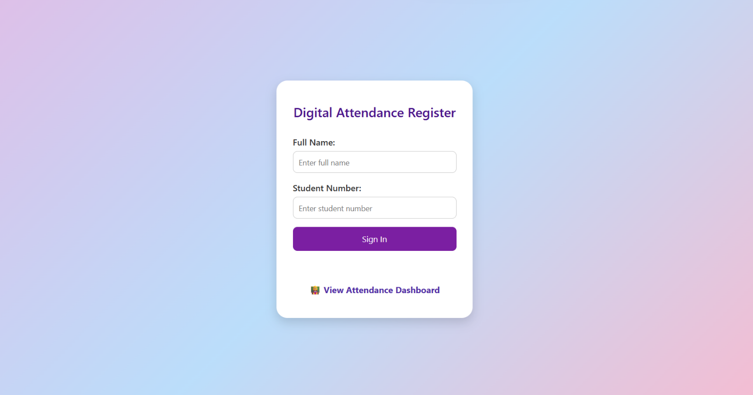
Admin Dashboard: A private-access dashboard allows administrators to view, filter, and export attendance data.
Technology Stack
Front-End: HTML5, CSS3, JavaScript
Back-End: PHP
Database: MySQL
Tools Used: VS Code, GitHub, and XAMPP for local development and testing.
Application Showcase
The system is composed of two primary interfaces: the user-facing sign-in form and the administrative dashboard.
Figure 1: The public-facing user sign-in form.

Slide 5
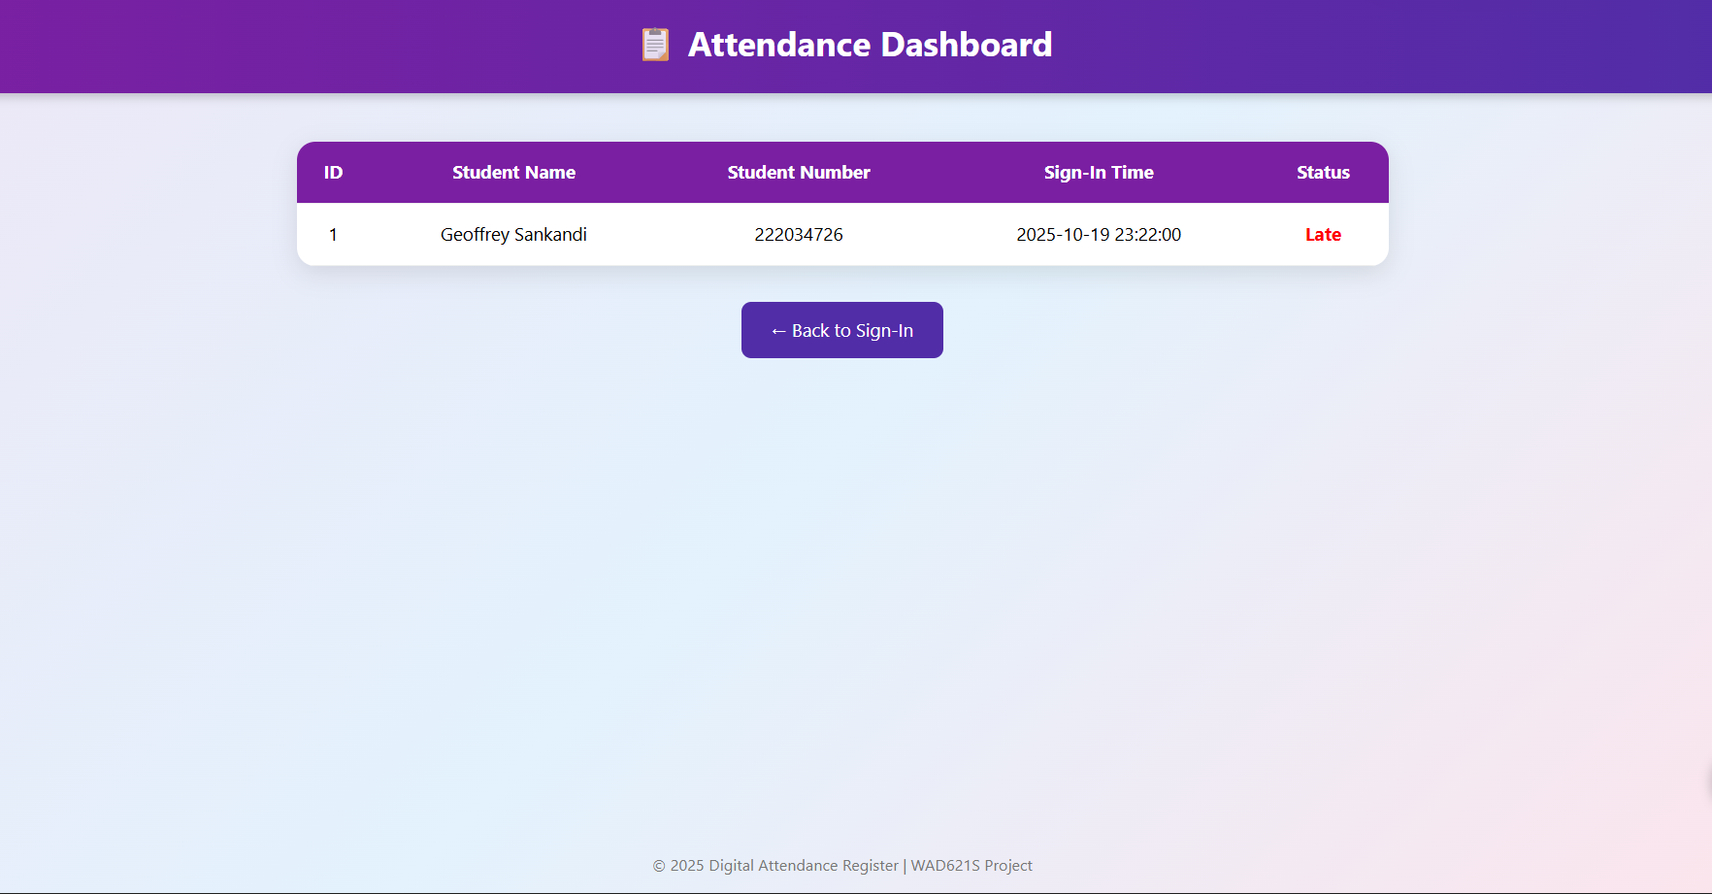
Figure 2: The administrative dashboard for viewing records.

Slide 6
Project Outcomes & Conclusion
Outcomes
This project successfully delivered on all its goals. The key outcomes include:
A functional and deployed digital attendance register web application.
An improved understanding of full-stack web technologies and how HTML, CSS, JavaScript, PHP, and MySQL interact.
Practical experience in teamwork, version control (GitHub), and iterative develop- ment.
Conclusion
The Digital Attendance Register project successfully met all its objectives, replacing an outdated manual process with an efficient, accurate, and reliable digital solution. The application is easy to use and provides clear benefits for both users and administrators.
This project serves as a strong foundation that could be expanded upon for wider use within an institution.

